Slide 1
BEFORE WE BEGIN
Dashboards were never
the goal. Better decisions were.
Notes:
TIME 0:45 | ELAPSED 0:45
Open cold and speak slowly.
“A few years ago, I would have described a great dashboard in terms of KPIs, filters, and design. My answer is different today. Dashboards were never the goal. Better decisions were.”
Pause, then advance.

Slide 2
SIGNALS BY THAD
From Dashboards to
Operational Intelligence
A Capability Model for Decision-Centered Public Health
Thaddeus D. Leavell, MHI, RHIA
Signals by Thad
Decision strategy · Data governance · Operational intelligence
signalsbythad.com
Notes:
TIME 0:40 | ELAPSED 1:25
Introduce yourself and frame the session.
“I’m Thaddeus Leavell with the Decision strategy · Data governance · Operational intelligence. This is a leadership story about how trusted information can improve operational decisions. It is not a software demonstration.”

Slide 3
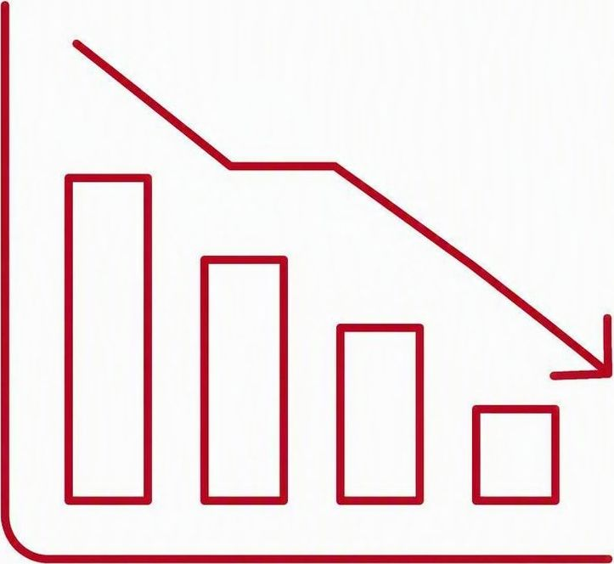



THE CHALLENGE
The Question We Faced
No shortage of data, reports, or dashboards — yet leadership still struggles to answer the operational questions that matter most.
Where are we falling behind?
What should we prioritize?
Can we trust the information?
How do we improve performance?
“The challenge wasn't a lack of data. It was transforming data into confident operational decisions.”
From Dashboards to Operational Intelligence
2
Notes:
TIME 1:30 | ELAPSED 2:55
State the decision problem.
“We had plenty of data, reports, and dashboards. Leaders still needed clear answers about backlogs, priorities, trust, and performance.”
Briefly mention the experience of two teams bringing different answers to the same operational question. Do not expand into a long story.

Slide 4
REFLECTIVE PAUSE
A Reflective Pause
Does your organization have dashboards?
For most of us, the answer is probably yes.
How often does a dashboard actually change what your organization does?
The gap between information and action is our focus.
From Dashboards to Operational Intelligence
Notes:
TIME 1:00 | ELAPSED 3:55
Use this as a reflective pause. Do not request hands, chat responses, or other audience interaction.
“Consider two questions for a moment.
First, does your organization have dashboards? For most of us, the answer is probably yes.
Second, how often does a dashboard actually change what your organization does?
That difference between having information and using it to change an action is the gap I want to focus on today.”

Slide 5
A SHIFT IN THINKING
What Changed
Dashboards alone couldn't solve:
WE USED TO ASK
Data quality
“What dashboard should we build?”
Governance
Standard definitions
NOW WE ASK
“What decision are we trying to improve?”
Workflow visibility
Operational consistency
From Dashboards to Operational Intelligence
4
Notes:
TIME 1:25 | ELAPSED 5:20
Contrast the two questions.
“We stopped beginning with what dashboard to build. We began with the operational decision that needed to improve.”
Name data quality, governance, definitions, and workflow visibility as the conditions that make the answer trustworthy.

Slide 6
A REPEATABLE CAPABILITY
The Operational Intelligence Capability Model
A repeatable organizational capability that transforms trusted information into better operational decisions.
Better Decisions
Operational Intelligence
Analytics & Insights
READ BOTTOM-UP
Trust is built from the foundation up.
Trusted Information
Governance
Data Quality
Source Systems
Notes:
TIME 1:50 | ELAPSED 7:10
This is the signature model. Read it from the bottom upward.
Source systems support data quality. Governance supplies definitions and ownership. Together they create trusted information. Analytics places that information in context. Operational Intelligence supports better decisions.
Pause on Trusted Information. That is the hinge of the model.

Slide 7

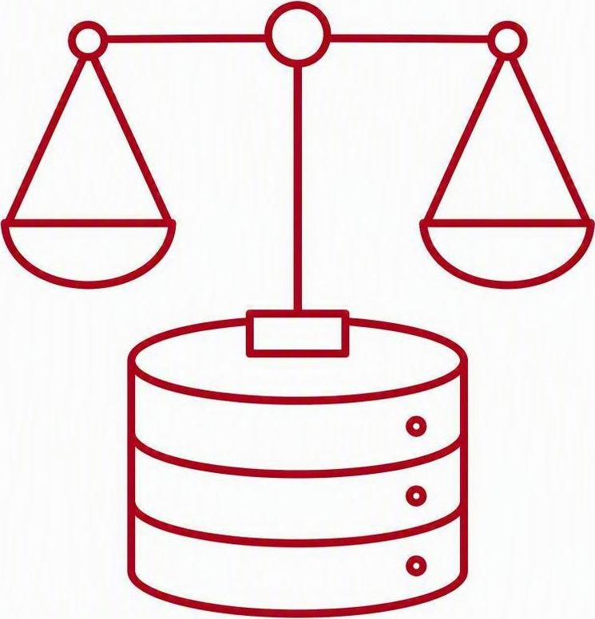

PEOPLE • PROCESS • TECHNOLOGY
Technology Enables It. People and Process Sustain It.
People
Process
Technology
Decision ownership
Leadership
Workforce capability
Governance
Standard definitions
Operational workflow
Continuous improvement
Dashboards
Analytics
AI
Automation
Technology enables it. People and process sustain it. Operational Intelligence requires all three.
From Dashboards to Operational Intelligence
Notes:
TIME 1:20 | ELAPSED 8:30
Do not read every bullet. Give one ownership example.
Technology is essential to Operational Intelligence. Dashboards, analytics, automation, and emerging capabilities such as artificial intelligence make trusted information accessible and usable at operational speed. But technology alone is insufficient.
People own the decisions: leaders interpret the signal, exercise authority, and choose the action. Process creates consistency and accountability by defining measures, workflows, thresholds, ownership, and review rhythms.
Operational Intelligence requires all three elements working together: people, process, and technology. For example, a dashboard can show that a queue crossed an aging threshold, but people and process determine who responds, what capacity moves, and when the result is reviewed.

Slide 8
THE OPERATIONAL PERFORMANCE CYCLE
Operational Intelligence Drives Performance
Operational
Data
Trusted
Information
Operational
Intelligence
Performance
Management
Continuous Improvement
Dashboards inform · Operational Intelligence enables · Performance Management improves
Measure
Again
Operational
Improvement
Leadership
Decisions
From Dashboards to Operational Intelligence
Notes:
TIME 1:30 | ELAPSED 10:00
Trace the cycle once.
Operational data becomes trusted information. Leaders interpret the signal, make a decision, act, and measure the result. New measurements begin the next cycle.
Emphasize that the value comes from repeated management behavior, not from publishing a finished report.

Slide 9
OPERATIONAL INTELLIGENCE / ILLUSTRATIVE EXAMPLE
OPERATIONAL INTELLIGENCE / ILLUSTRATIVE EXAMPLE
Certificate Demand and Fulfillment
Incoming demand and completed work reveal where open volume is changing.
WEEKLY TOTAL
VOLUME BY SERVICE CHANNEL
8,400
8,610
210
requests received
requests completed
fewer open requests
SIGNAL
+120
online requests added to open work
Other channels completed enough work to offset the increase.
SIGNAL
Online demand exceeds completions by 120 requests.
DECISION
Which channel needs capacity this week?
RESPONSE
Shift short-term capacity toward online processing.
Fictional data for illustration only
From Dashboards to Operational Intelligence
8
Notes:
TIME 1:40 | ELAPSED 11:40
Illustrative data only. All numbers are fictional and do not represent performance at an actual organization.
Use the same three-part pattern that will repeat across the next two examples: Signal, Decision, Response.
SIGNAL: Online demand exceeds completions by 120 requests. Overall, the organization received 8,400 requests and completed 8,610, so total open work declined by 210 even though the online channel moved in the opposite direction.
DECISION: Which channel needs capacity this week?
RESPONSE: Shift short-term capacity toward online processing.
The point is not simply that production improved. Operational Intelligence makes the management decision more specific by showing where demand and throughput have moved apart.

Slide 10
OPERATIONAL INTELLIGENCE / ILLUSTRATIVE EXAMPLE
Document Review Queue
Shared status definitions make review workload and quality patterns visible.
STATUS DISTRIBUTION
10,000 RECEIVED
STATUS
RECORDS
SHARE
Accepted
9,100
91.0%
Needs review
500
5.0%
91%
No review required
250
2.5%
accepted
Rejected
140
1.4%
In queue
10
0.1%
Five percent require manual review. Location patterns show where outreach can help.
SIGNAL
Five percent of records require manual review.
DECISION
Where should review effort focus?
RESPONSE
Focus on locations with recurring review patterns.
Fictional data for illustration only
From Dashboards to Operational Intelligence
9
Notes:
TIME 1:50 | ELAPSED 13:30
Illustrative data only. Keep staff and facility identities out of the discussion.
Again, use the same Signal, Decision, Response pattern.
This workflow becomes measurable only after governed status definitions are applied consistently. The statuses reconcile to 10,000 received records: 91 percent accepted, five percent requiring manual review, with the remaining records distributed among the other defined statuses.
SIGNAL: Five percent of records require manual review.
DECISION: Where should review effort focus?
RESPONSE: Focus on locations with recurring review patterns.
The governed statuses create a common language for action, while facility patterns help distinguish isolated record issues from recurring training, workflow, or system issues.

Slide 11
OPERATIONAL INTELLIGENCE / ILLUSTRATIVE EXAMPLE
Search Queue and Service Performance
Throughput and aging together show whether service risk is actually declining.
SIX-MONTH THROUGHPUT
OPEN REQUESTS BY AGE
300
requests are older than 20 days
SIGNAL
300 requests remain more than 20 days old.
DECISION
Where should capacity go to reduce aging?
RESPONSE
Protect throughput while concentrating effort on the oldest work.
Fictional data for illustration only
From Dashboards to Operational Intelligence
10
Notes:
TIME 1:40 | ELAPSED 15:10
Illustrative data only. Point to both throughput and aging.
Complete the same Signal, Decision, Response pattern.
Completed work exceeds incoming demand by 380 during the period, but the aging distribution shows that strong throughput has not automatically resolved the oldest work.
SIGNAL: 300 requests remain more than 20 days old.
DECISION: Where should capacity go to reduce aging?
RESPONSE: Protect throughput while concentrating effort on the oldest work.
Leadership would then monitor whether the oldest group declines without causing new aging elsewhere. The combination of throughput and aging supports a more defensible staffing decision than either measure alone.

Slide 12
HONEST REFLECTION
What We Got Wrong
01
02
03
We believed dashboards would solve the problem
We underestimated governance
We waited too long to standardize definitions
The dashboard was never the fix — the decision behind it was.
Trust in the numbers took far longer to build than any report.
Aligning on what each metric meant should have come first.
Those lessons fundamentally changed how we build information systems today.
11
Notes:
TIME 1:30 | ELAPSED 16:40
Own the lessons directly.
“We believed the dashboard would solve the problem. We underestimated governance, and we standardized definitions too late.”
The correction was to start with the decision, establish ownership, and agree on the measure before building the view.

Slide 13
MONDAY MORNING
What Leaders Can Do Monday Morning
1
Identify — one operational decision that matters
2
Define — trusted measures for that decision
3
Review — performance consistently
4
Act — on what the information reveals
5
Measure — the results, then repeat the cycle
Operational Intelligence becomes valuable only when it changes leadership behavior.
From Dashboards to Operational Intelligence
12
Notes:
TIME 1:45 | ELAPSED 18:25
Give the audience a practical starting point.
Choose one operational decision. Define the trusted measures behind it. Review the measures on a consistent schedule. Act on the signal, then measure whether the action worked.
“Every leader in this room already owns a decision that can begin this cycle on Monday.”

Slide 14
WHY THIS MATTERS
Trusted information helps leaders make better decisions.
Better decisions improve performance.
Better performance strengthens public health.
Better decisions build better public health.
Notes:
TIME 1:20 | ELAPSED 19:45
Keep the close executive and concise. Pause briefly between each statement.
“Trusted information helps leaders make better decisions.
Better decisions improve performance.
Better performance strengthens public health.
Better decisions build better public health.”
Pause before advancing.

Slide 15
Thank You
Better decisions start with information people trust.
Thaddeus D. Leavell, MHI, RHIA
Signals by Thad
Decision strategy · Data governance · Operational intelligence
signalsbythad.com
Notes:
TIME 0:45 | ELAPSED 20:30
Thank the audience.
Restate the takeaway in one sentence: “Operational Intelligence is an organizational capability that turns trusted information into better operational decisions.”
Invite follow-up conversations after the session and end.

